Slide 1

Information about project
Hi, welcome to my project. I want to inform you about my project. I work with two datasets. One of them began at end of the November (Heart Attack). After you said the dataset is more important for you I create data(Home) by myself then I work with this data.

Slide 2
Bahram Muzaffarli
Project

Slide 3

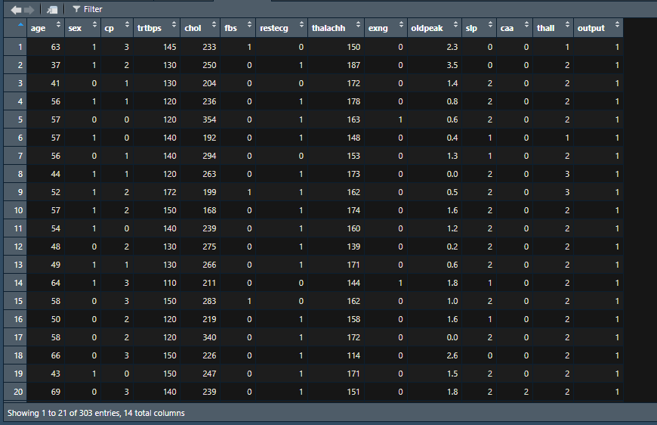

Two Data
Heart Attack (from kaggle.com)
Home (create by myself)
Every single code in this presentation was written by myself.

Slide 4
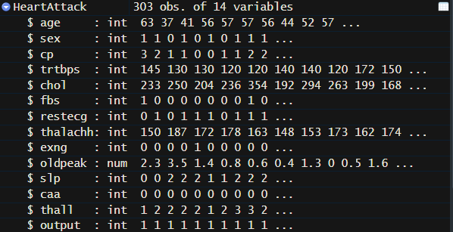
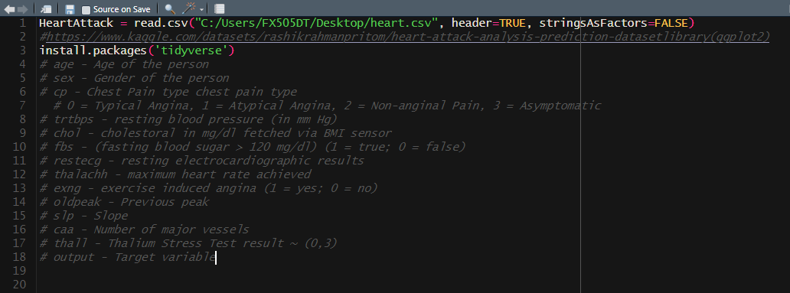
Main points of data
Variable Types

Slide 5

Heart Attack Data

Slide 6
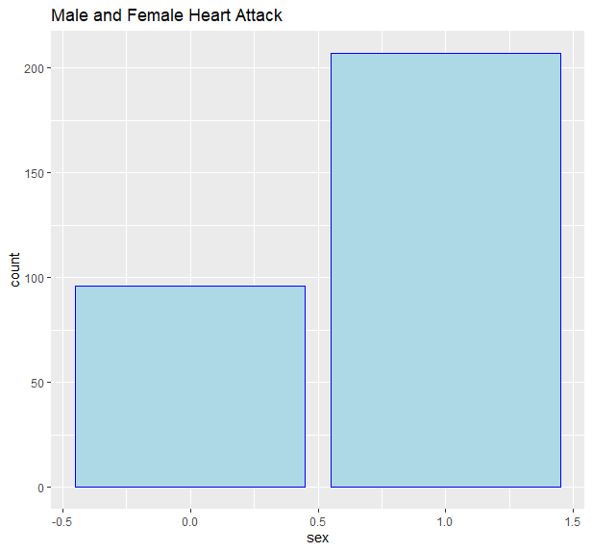
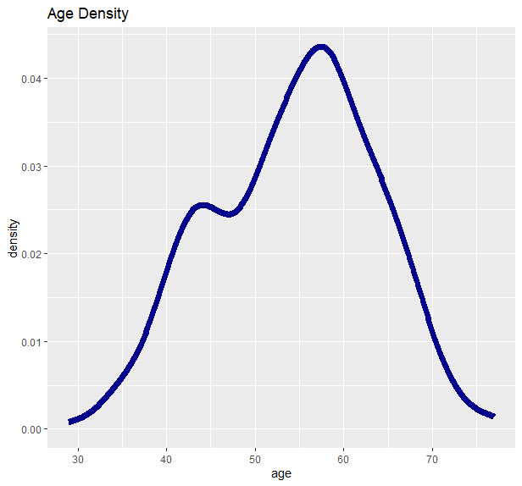

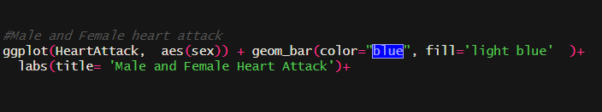
Male and Female
heart attack
Age Density

Slide 7
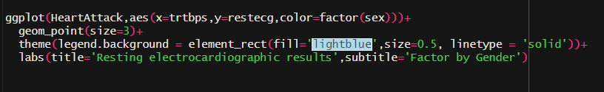
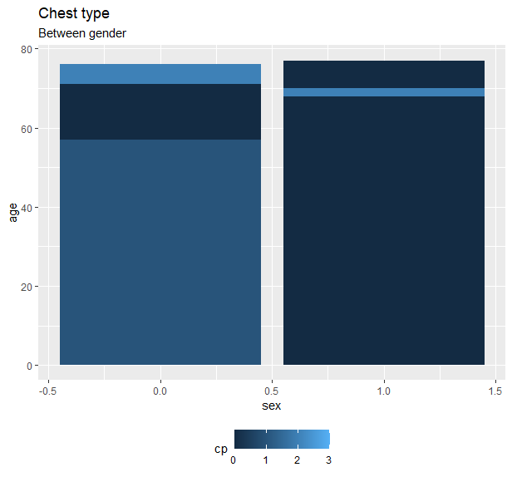
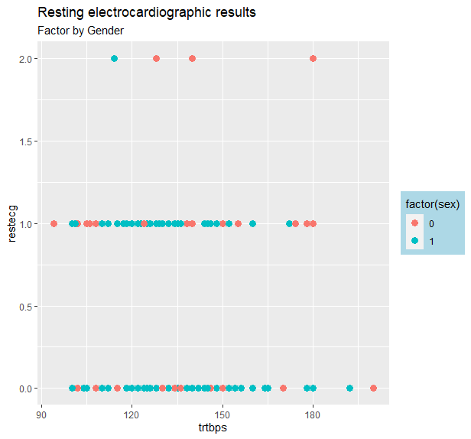
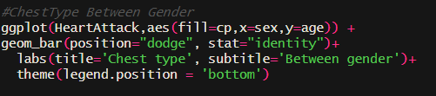
Chest Type Between Gender
Resting result

Slide 8
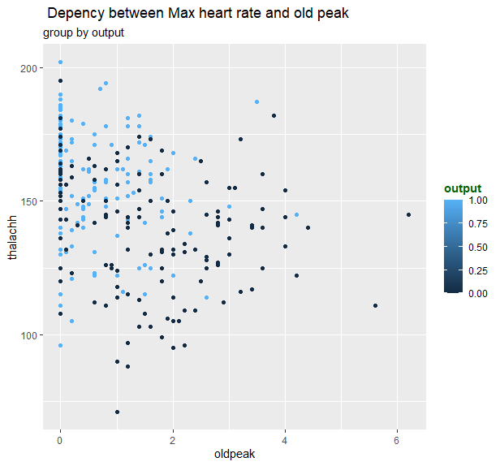
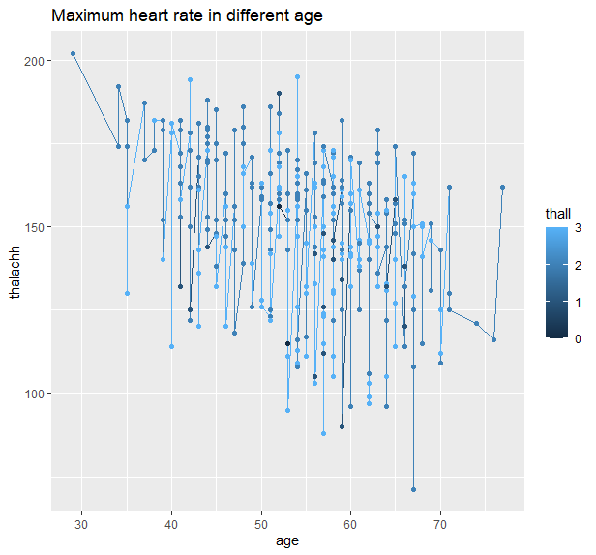
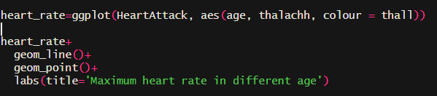

Max heart rate and old peak dependency
Max heart rate in different age
Group by output information

Slide 9

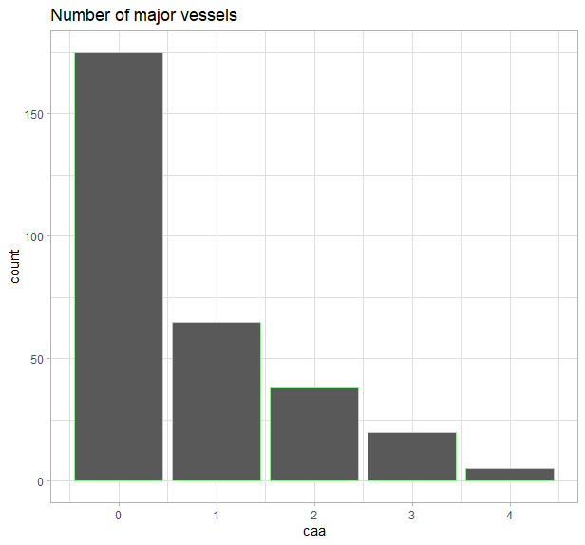
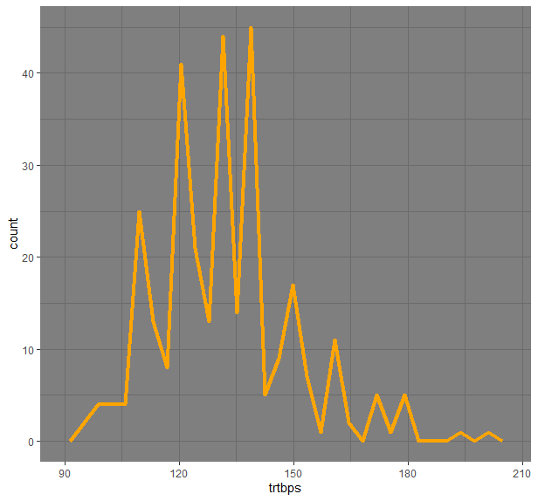
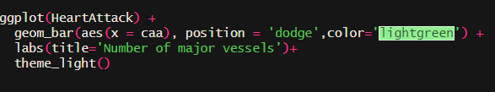
Blood pressure density
Number of major vessels

Slide 10
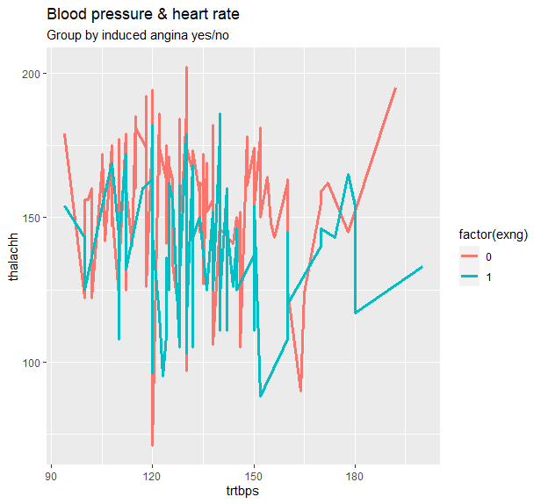
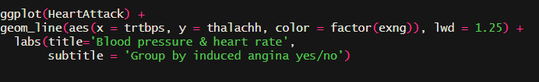
Dependency between blood pressure and heart rate
Angina = yes/not

Slide 11
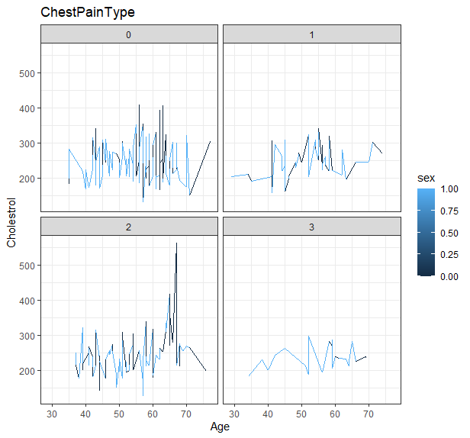
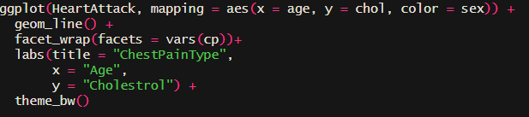
Cholestrol by Age group by Chest Pain Type

Slide 12
House Data

Slide 13
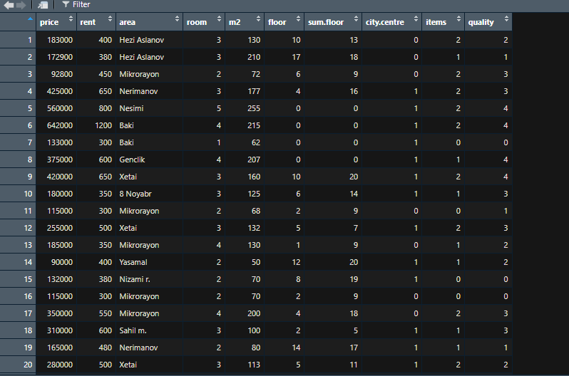
Two Data
Heart Attack (from kaggle.com)
Home (create by myself)
Every single code in this presentation was written by myself.

Slide 14
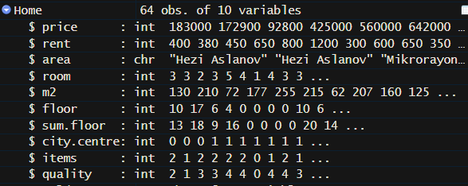
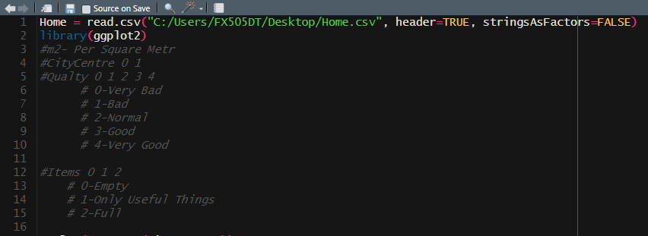
Main points of data
Variable Types

Slide 15
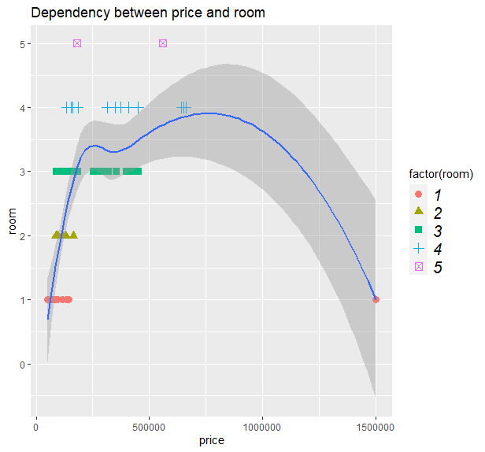

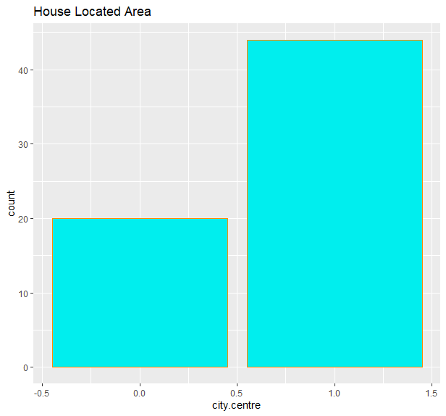
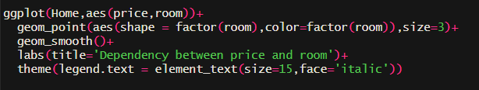
House Located Area
(City Centre 0/1)
Price Room counts dependency

Slide 16
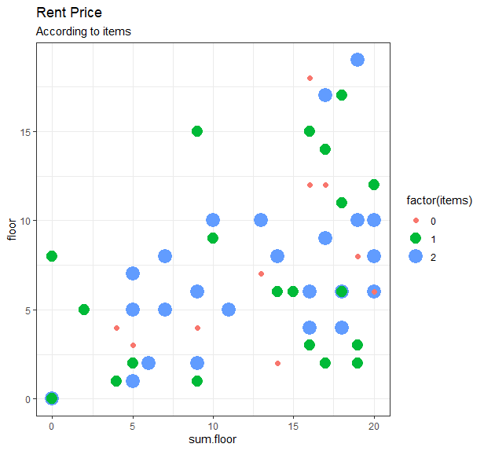
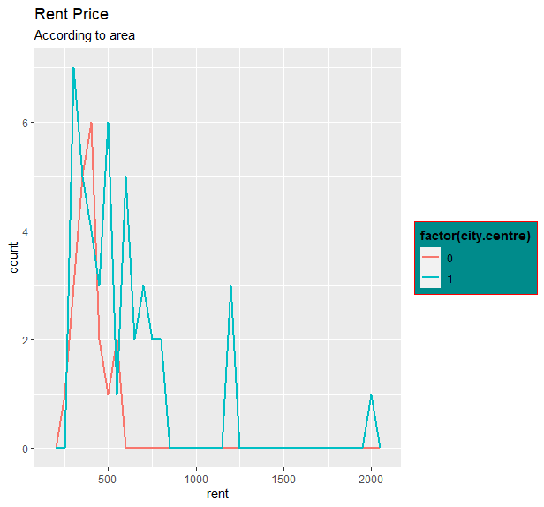
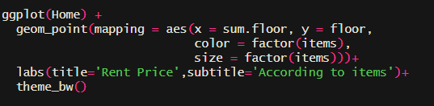
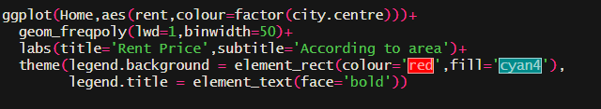
Sum.floor and floor compare according to items
Rent Price according to area

Slide 17
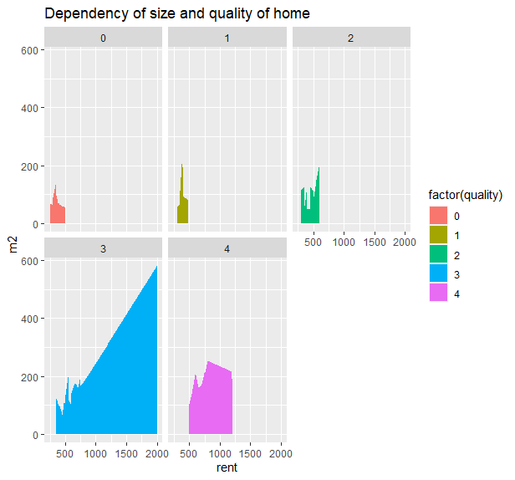

Surface and quality of house

Slide 18
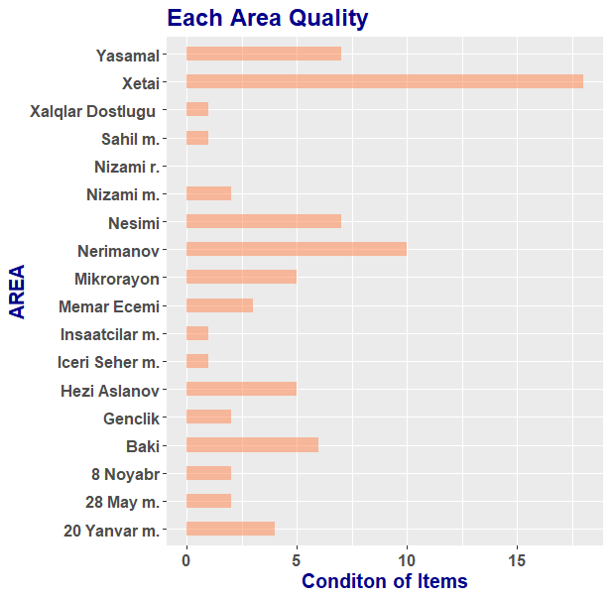
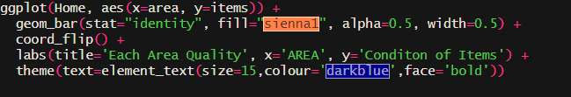
Items condition for each area

Slide 19
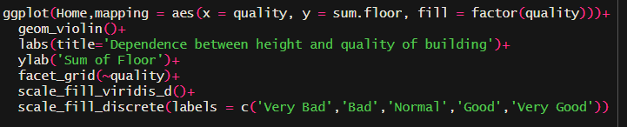
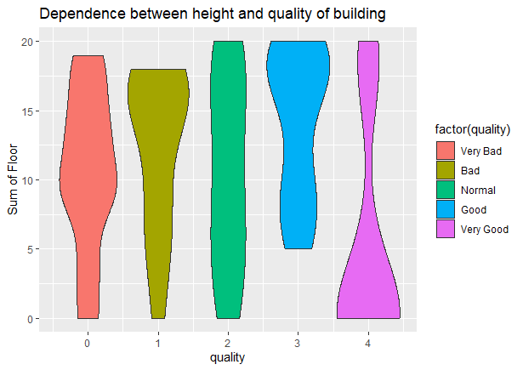
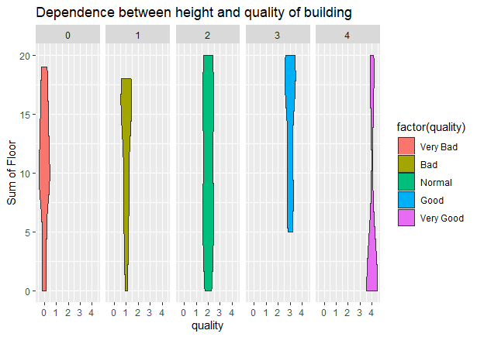
Dependence between height and quality of building
Without facet_grid
With facet_grid

Slide 20

Thank You
For your attention !

